Slide 2
Web Camp Introduction to Asp.Net 5 Asp.Net core 1.0 RC1
Mathieu Richard
GSoft
blog: www.matrichard.com
Twitter: @matrichard5

Slide 3
The foundation: tools & frameworks
Visual Studio 2015
ASP.NET Core
Azure
Package Managers
Notes:
Note the S in package managerS

Slide 4


Visual Studio 2015: The editor for serious web dev
HTML5 / CSS3 standards and smarts
JavaScript language features
Page Inspector + Browser Link
One code editor for client and server
Web Extension Pack
(we’ll look at Visual Studio Code, too…)

Slide 5
ASP.NET and Web Tools Cadence
Rapid releases | Continuous Updates | Match the Speed of Web Dev
Visual Studio 2015
Visual Studio 2015.1
7/22/2015
11/30/2015
2013
Oct
2014
Apr
Jul
Oct
2015
Apr
Jul
Oct
2015
10/1/2013
1/15/2014
5/14/2014
8/13/2014
11/19/2014
7/15/2015
Visual Studio 2013
Visual Studio 2013.1
Visual Studio 2013.2
Visual Studio 2013.3
Visual Studio 2013.4
Visual Studio 2013.5

Slide 6

NuGet: The smart, easy way to manage .NET dependencies
Before NuGet:
Find the latest release
Install and configure in your project
Handle dependencies and versions
Updates with dependency checking
Common list of installed packages
Simplified uninstalls
Streamlined deployment with Package Restore

Slide 7
Visual Studio 2015 and ASP.NET Core: Support for npm, bower, gulp, grunt, etc.
npm
bower
grunt
gulp

Slide 8



ASP.NET 4.6 and ASP.NET Core 1.0
ASP.NET 4.6
ASP.NET Core 1.0
.NET Framework 4.6
.NET Core 1.0
.NET framework libraries
.NET core libraries
Compilers and runtime components (.NET Compiler Platform: Roslyn, C#, VB, F# Languages, RyuJIT, SIMD)

Slide 9
What about ASP.NET 5?
ASP.NET Core 1.0 was previously called ASP.NET 5
It was renamed in January 2016
You’ll still see it referred to as ASP.NET in Visual Studio and in some docs
Will be updated in next ASP.NET Core Release Candidate

Slide 10
ASP.NET Core 1.0 Roadmap
Milestone | Release week
Beta6 | 27 Jul 2015
Beta7 | 2 Sep 2015
Beta8 | 15 Oct 2015
RC1 | Nov 2015
RC2 | TBD
1.0.0 | TBD 2016
https://github.com/aspnet/home/wiki/roadmap

Slide 11

ASP.NET 4.6 and ASP.NET MVC 5 Recent Updates

Slide 12
One ASP.NET
Released with Visual Studio 2013
Sites
Services
YOU!
Web
Forms
Web
Pages
Single
Page
Apps
MVC
Web
API
SignalR
YOU!
ASP.NET

Slide 13
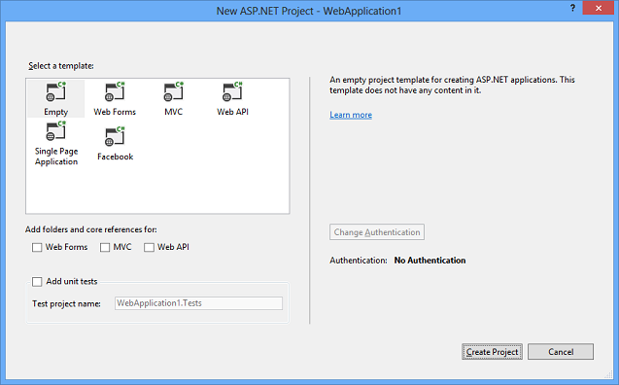
One ASP.NET
Visual Studio 2013 – New ASP.NET Project
Notes:
Visual Studio 2013 and ASP.NET 4.5 merged the different project types, so you really could create an ASP.NET project with Web Forms, MVC and Web API easily.

Slide 14
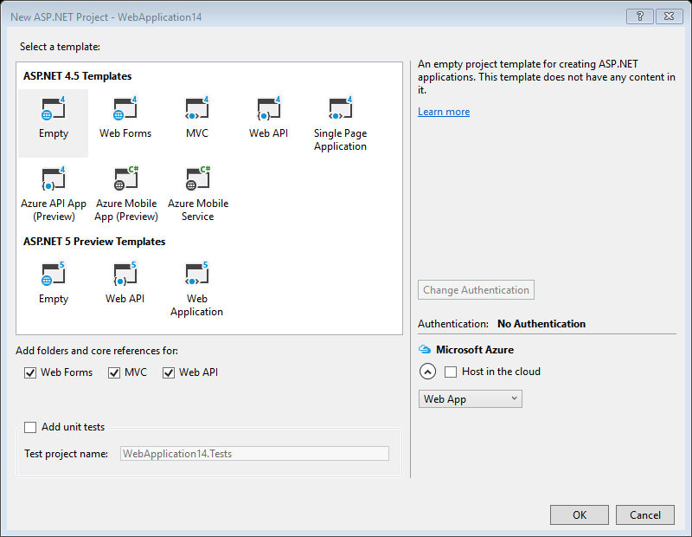
ASP.NET Core 1.0: New, but still one project type
Visual Studio 2015 – New ASP.NET Project
Notes:
Okay, in a way, we’re sort of back to two ASP.NETs with Visual Studio 2015. ASP.NET 5 introduces some breaking changes and doesn’t support Web Forms, so a separate template type.
However, the momentum of One ASP.NET has continued with ASP.NET 5. Because MVC and Web API have merged in ASP.NET 5, there are fewer project types in the ASP.NET Preview Templates.

Slide 15
Visual Studio 2015
Top Features for Web Developers
NPM Integration
JSON Editor
Browser Link
Web Essentials
HTML Editor
JavaScript Editor

Slide 16
Now MVC and Web API
are just features of
ASP.NET Core

Slide 17
ASP.NET Core 1.0
One set of concepts – remove duplication
Web UI and Web APIs
Smooth transition from Web Pages to MVC (future)
Built DI first
Runs on IIS or self-hosted

Slide 18
Deploying ASP.NET Apps to the Cloud with Azure
Microsoft Azure Web Sites (10 free!)
Fast site creation and deployment
Nothing new to learn
Easy to scale

Slide 19


ASP.NET Core 1.0 – Key Values
Totally Modular
Faster Development Cycle
Seamless transition from on-premises to cloud
Choose your Editors
and Tools
Open Source with Contributions
OSS
Cross-Platform
Fast

Slide 20
TagHelpers
HTML helpers expressed as tags
Ex. Instead of:
@Html.LabelFor(m => m.UserName, new { @class = "col-md-2 control-label" })
Write this:
<label asp-for="UserName" class="col-md-2 control-label"></label>
Easier to customize with additional attributes
Work seamlessly with the HTML editor

Slide 21
ASP.NET Identity
The ASP.NET Identity system is designed to replace the previous ASP.NET Membership and Simple Membership systems. It includes profile support, OAuth integration, works with OWIN, and is included with the ASP.NET templates shipped with Visual Studio 2013.
The ASP.NET Identity system from ASP.NET 4.x forms the basis for the ASP.NET Identity system used in ASP.NET Core 1.0.

Slide 22
Demo
Getting started with ASP.NET Core 1.0

Slide 23
Ressources
-Documentation: docs.asp.net
-Github repo: https://github.com/aspnet
-channel9: https://channel9.msdn.com/Tags/asp.net

